Slide 1
Image Representation

Slide 2
Pixel
(0,0)
(0,1)
(0,2)
(0,7)
(1,0)
(2,0)
(2,3)
(3,1)
(3,3)
(3,7)
(4,6)
Storing it into a digital system
(5,3)
(3,4)
(6,6)
(7,0)
(7,7)
Original image we see
8x8 pixel

Slide 3
Grey Scale Image
(0,0)
(1,1)
(1,2)
(0,7)
15
15
15
15
(1,0)
15
(2,0)
(2,3)
15
3
(3,1)
(3,3)
(3,7)
15
0
15
(4,6)
15
(5,3)
(3,4)
0
0
(6,6)
13
(7,0)
(7,7)
15
15
256
15
14
9
1
0
16 colour scales

Slide 4
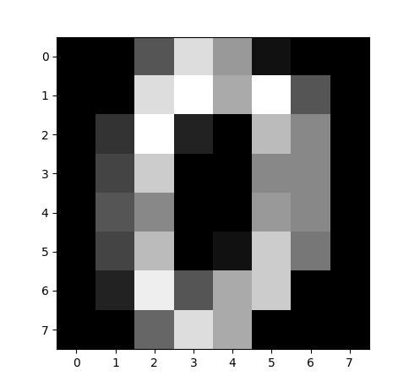
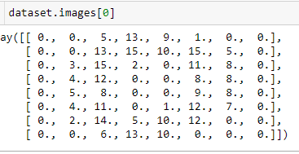
MINST Data Set in Numpy Array
0
0
5
13
9
0
15
10
15
3
4
0
5
0
15
14
9
1
0
16 colour scales
14

Slide 5
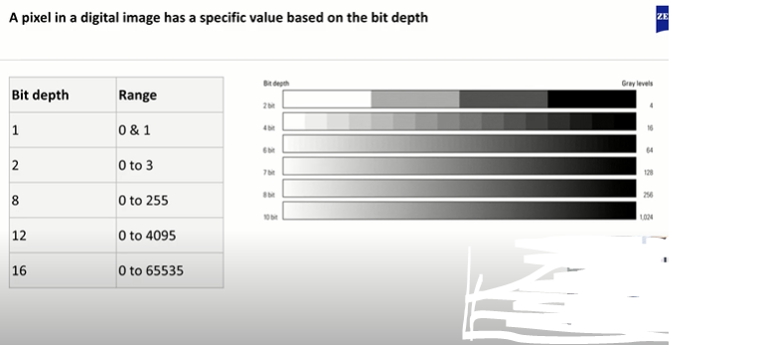
Unsigned Intigers
If the bit depth is 8 , that mean the pixel value ranges from 0 to 255, ie 2⁸ -1

Slide 6


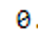
Grey Scale To Binary
1
0
0
1
1
0
0
0
0
0
5
13
9
0
0
0
0
1
1
1
1
0
0
0
13
15
10
15
5
0
0
0
1
0
0
2
Threshold =8
If pixel < 8 :
pixel =0
Else :
Pixel =1
0
0
1
0
0
1
1
0
3
15
0
11
8
0
0
0
0
12
0
8
0
0
0
1
0
0
1
1
0
4
0
8
4
0
8
0
0
9
0
0
1
0
0
1
1
0
5
8
0
0
0
0
1
0
0
1
0
0
4
11
0
12
7
0
0
4
0
0
2
10
12
0
0
1
0
1
1
0
0
0
14
5
0
0
0
0
0
6
13
10
0
0
0
0
0
0
1
1
0
0
0
Gray Scale To -
Binary Images

Slide 7
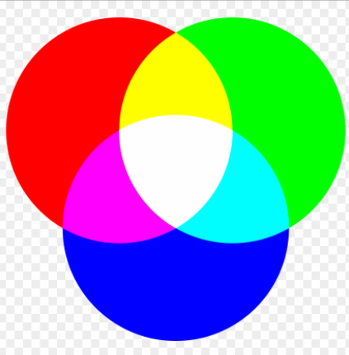
RBG Color Space
0
100
125
253
255
0
100
125
253
255
Scale of 0 to 254 for red to white
Scale of 0 to 254 for green to white
0
100
125
253
255
Need Three channels to represent RBG
Scale of 0 to 254 for blue to white

Slide 8
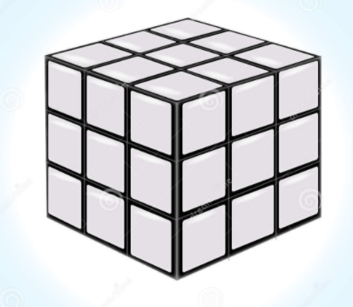
Representation of color
163, 136, 113]
160, 130, 111]
(0,0,0)
(0,2,2)
(0,1,0)
(0,2,1)
(0,2,0)
(0,2,0)
(1,0)
(1,2)
(1,2)
(2,0)
0
100
125
253
255
(2,1)
Scale of 0 to 254 for red to white
(2,2)
(2,2)
Viewing
Green
RED
0
100
125
253
255
Scale of 0 to 254 for blue to white
Blue
3x3 pixel Color Image
With 3 channels
0
100
125
253
255
*4 the channel is transparency
And more for IR ,UV etc
Scale of 0 to 254 for green to white

Slide 9
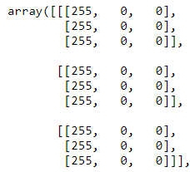
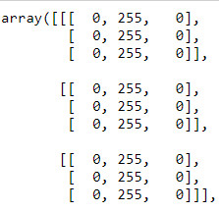
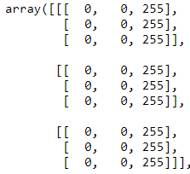
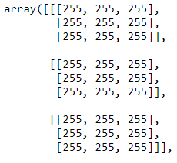
Image Representation
img[ :, :, 0] =255
img[ :, :, 1] =255
img[ :, :, 2] =255
img[ :, :, :] =255
Blue
Green
RED
White

Slide 10
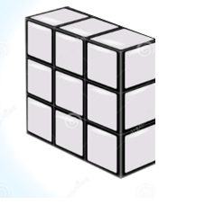
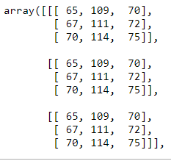
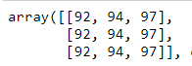
Color to gray scale
Gray = (Red * 0.3 + Green * 0.59 + Blue * 0.11)
Gray (First Cell) = (70 * 0.3 + 109 * 0.59 + 65 * 0.11) = 92.46
Example calculation
Gray (white) = (255* 0.3 + 255 * 0.59 + 255 * 0.11) = 255
Greyscale 0 is black and 255 is white
Gray (black) = (0* 0.3 + 0 * 0.59 + 0 * 0.11) = 0

Slide 11
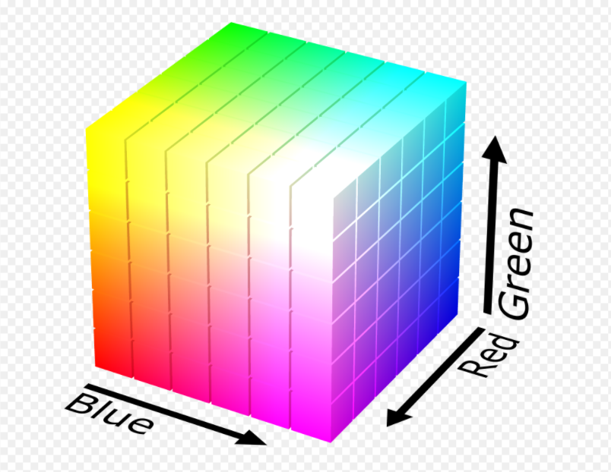
RBG Color Space
0
100
125
253
255
Scale of 0 to 254 for blue to white
0
100
125
253
255
Scale of 0 to 254 for green to white
0
100
125
253
255
Scale of 0 to 254 for red to white
Need Three channels to represent RBG

Slide 12
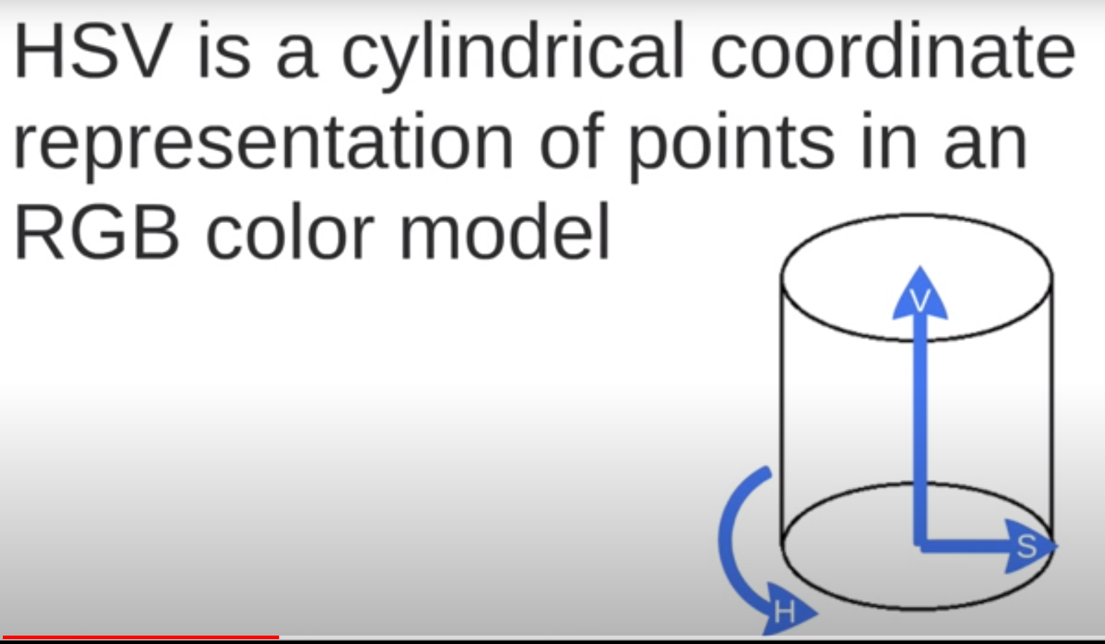
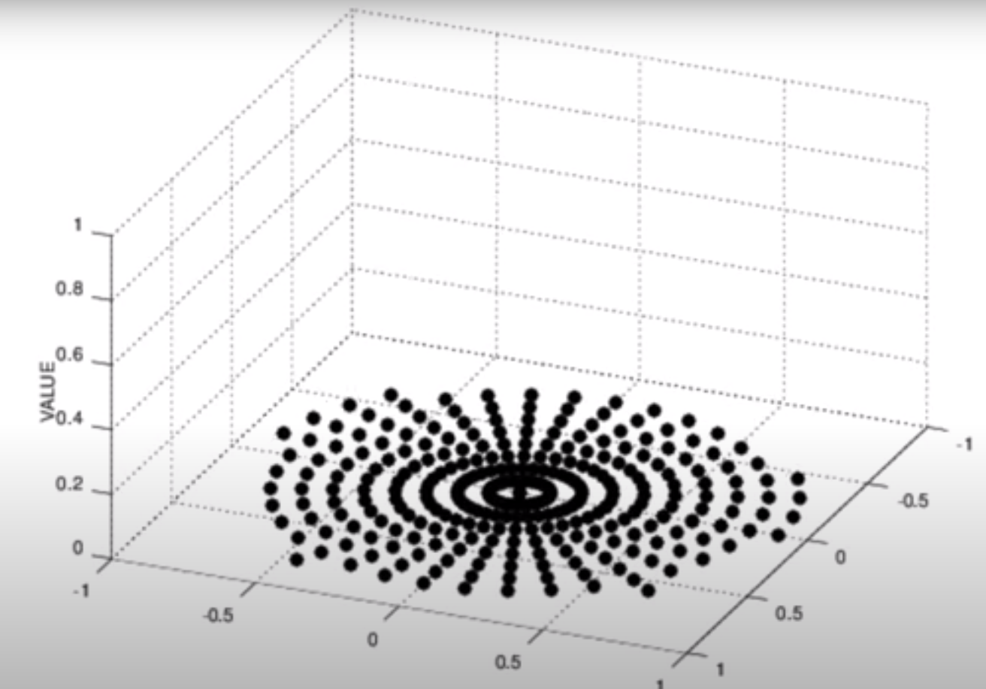
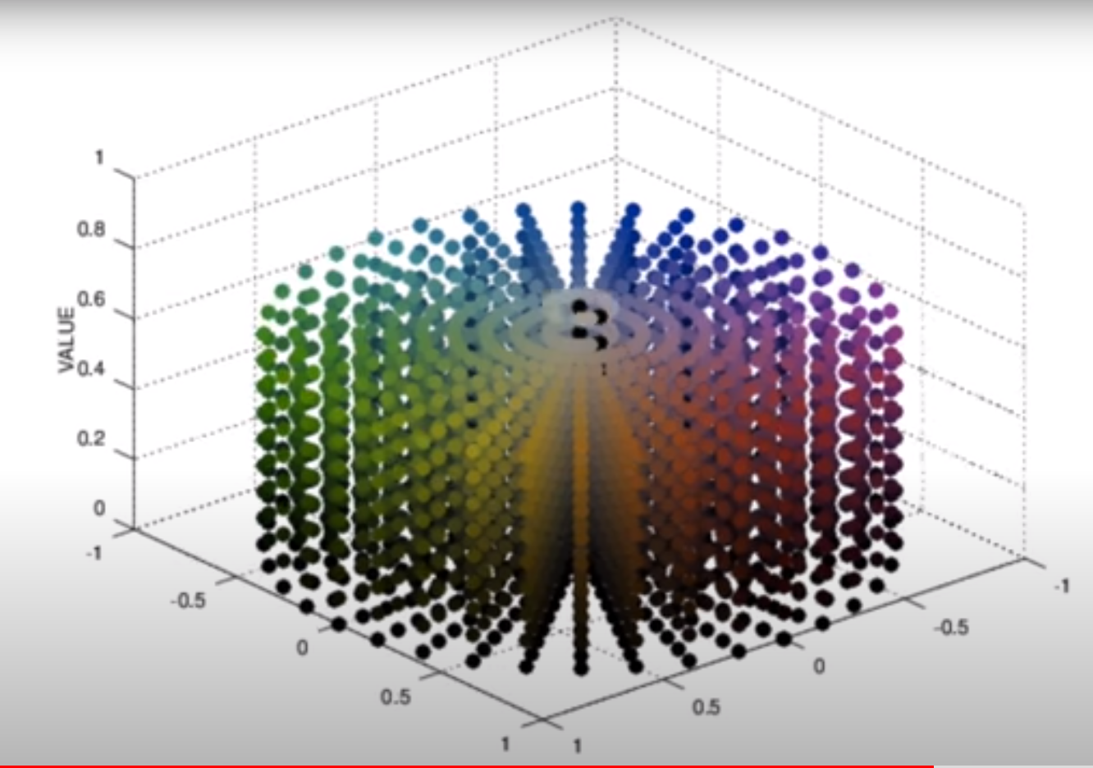
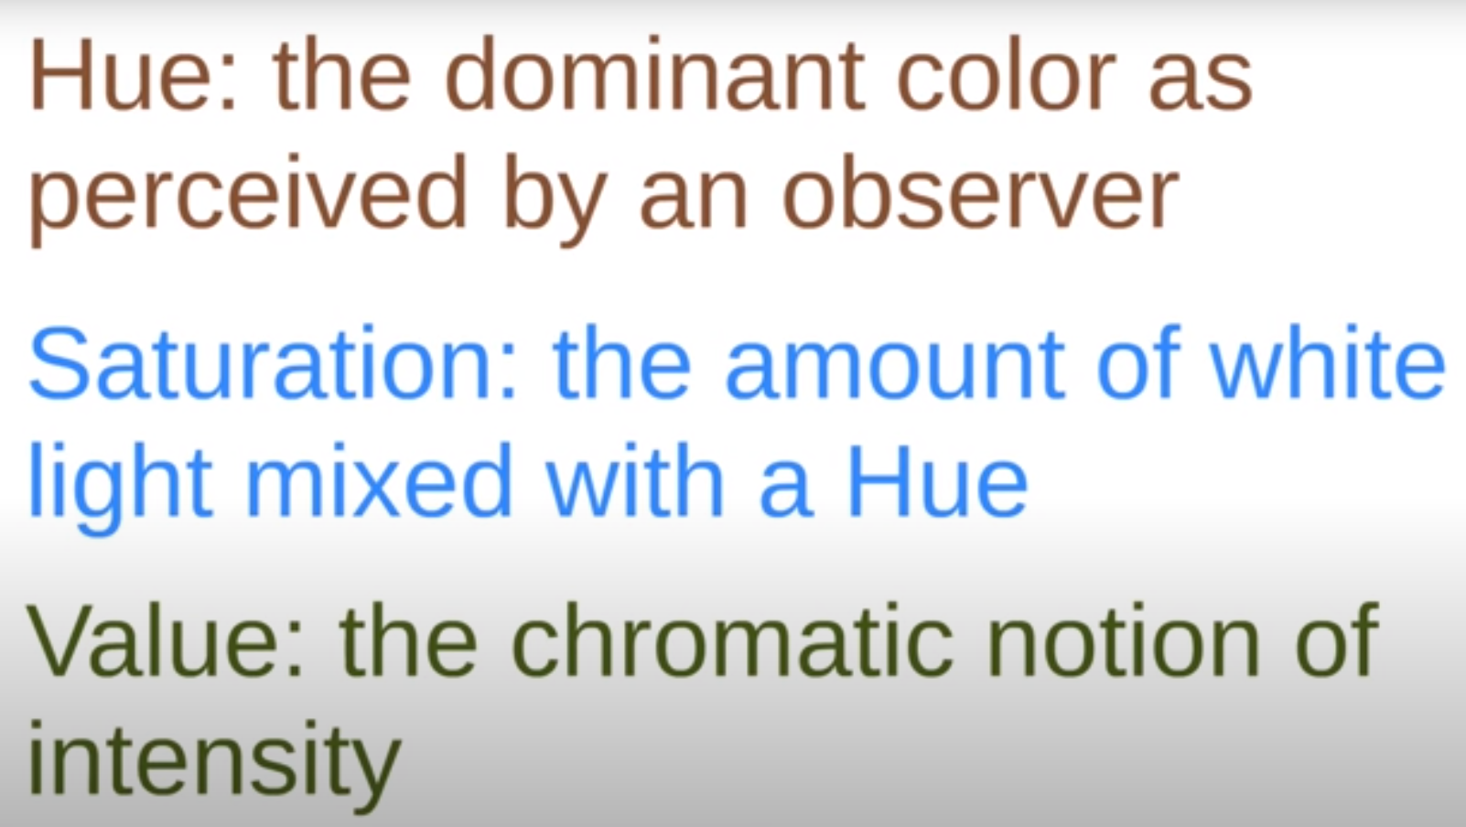
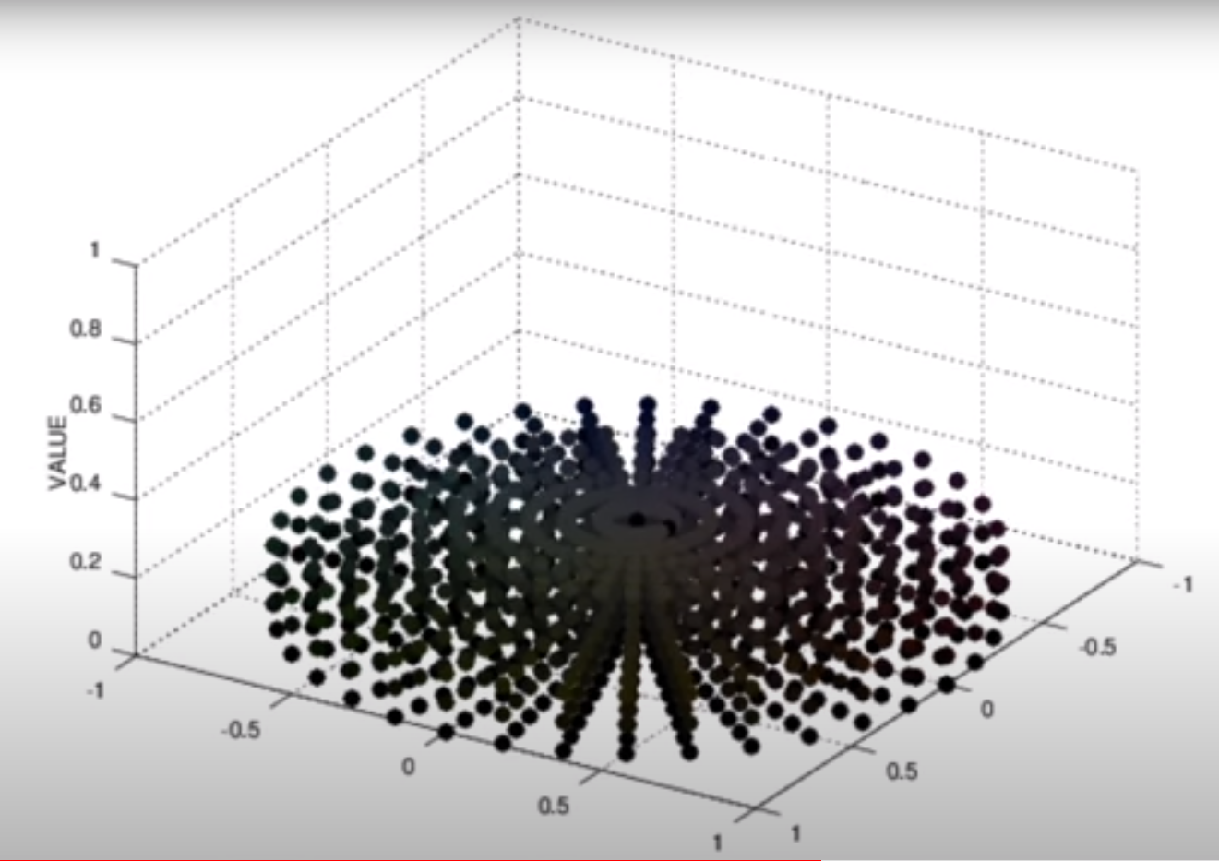
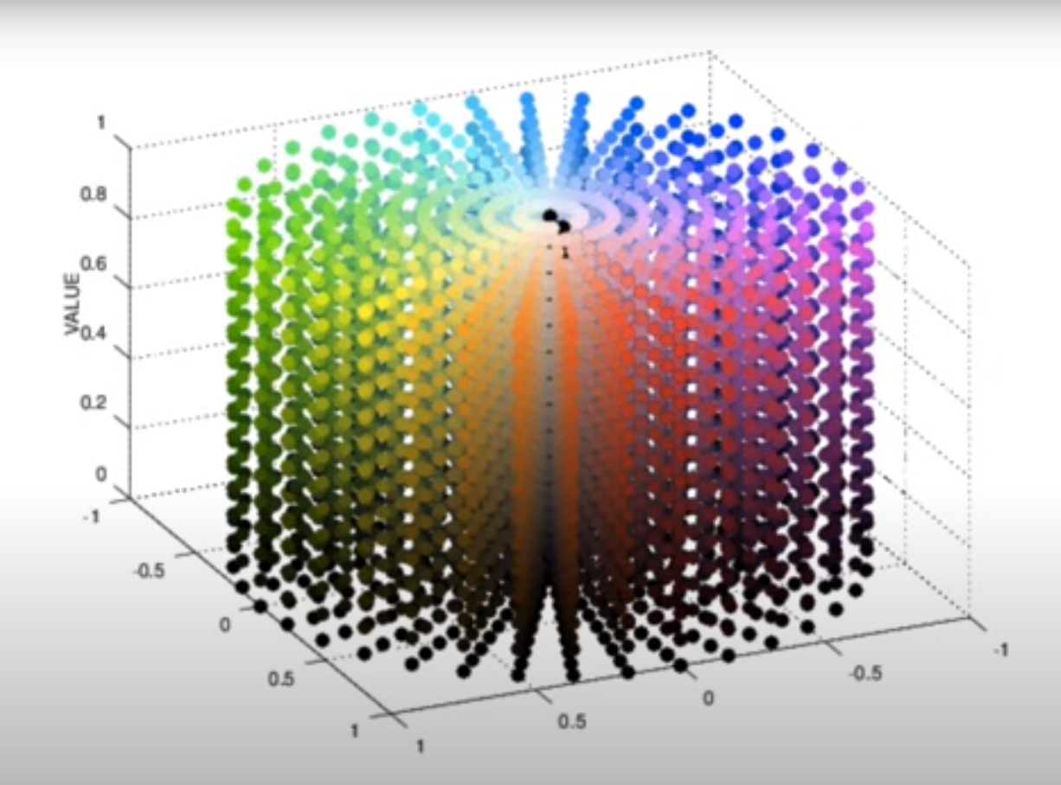
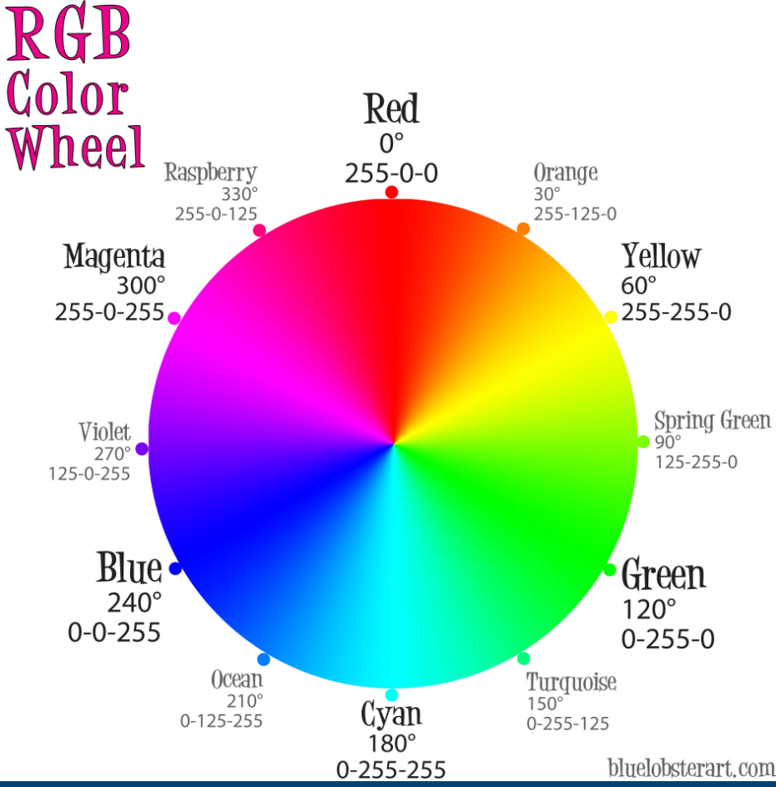
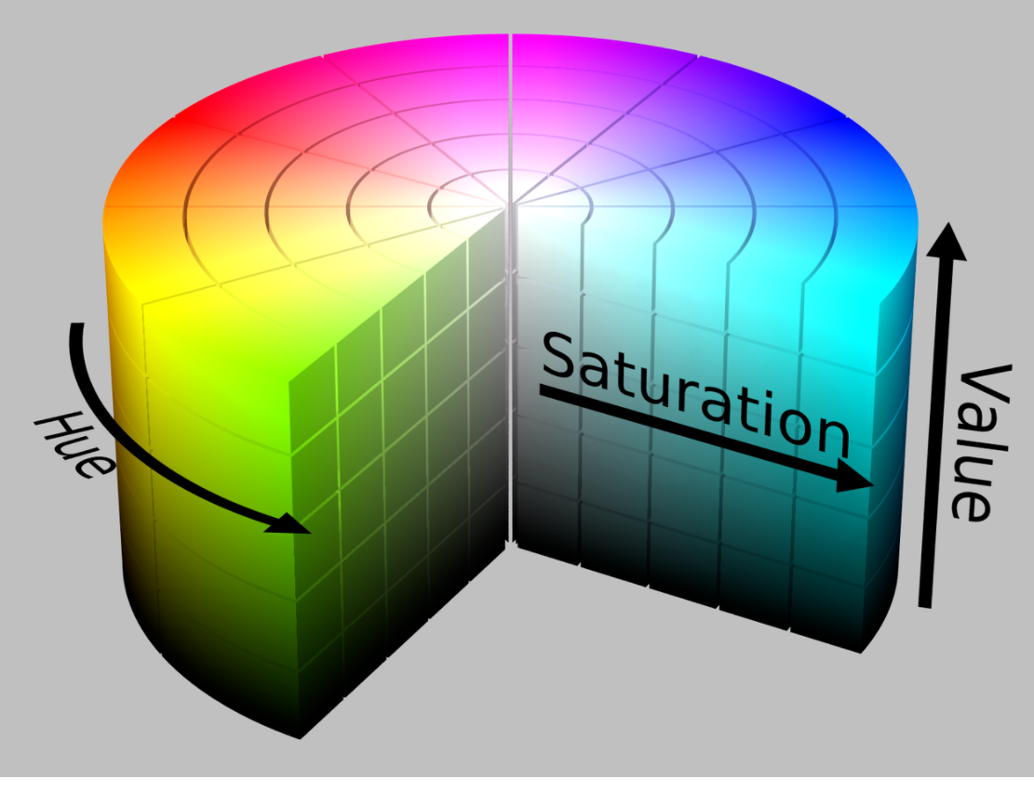
HSV Color Space
?????
??????
?????
saturation
saturation
Sat :Amount of grey in color
Value /brightness :amt of white

Slide 13
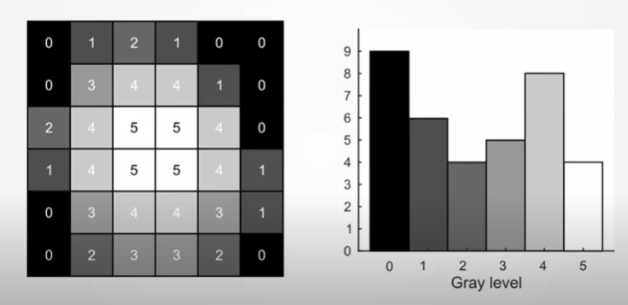
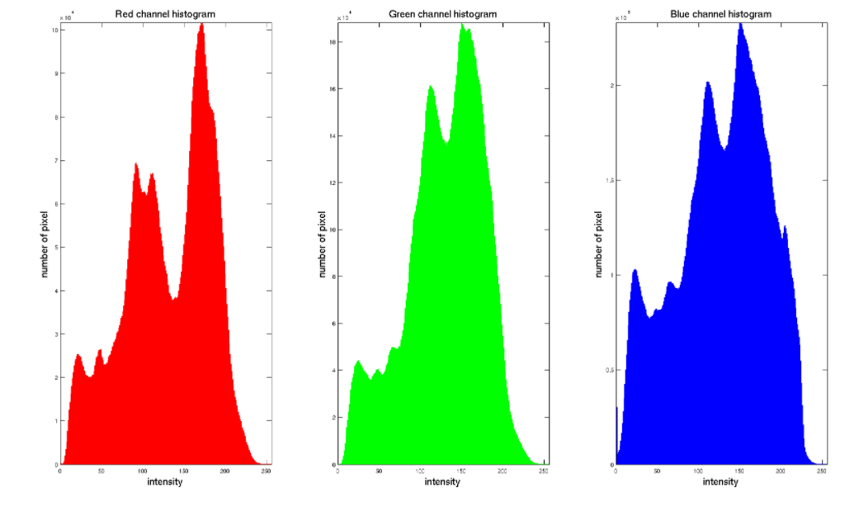
Histogram Representation of Pixels
All the pixel values of an image can be represented as a histogram.
Below an example of histogram of a Gray scale image pixels and colour image.

Slide 14
Generic Terms

Slide 15
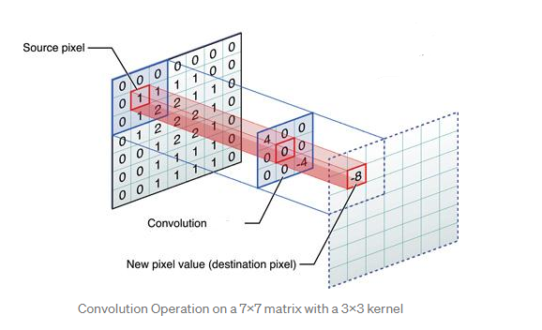
Kernels, Convolution and Filters
Image Matrix
3 X3 Kernel
Resultant Pixel
Convolution is nothing but one to one multiplication of two matrix (Here it is image matrix and the Kernel)
Notes:
https://medium.com/@bdhuma/6-basic-things-to-know-about-convolution-daef5e1bc411?p=95fb03f45a9

Slide 16
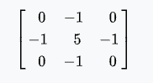
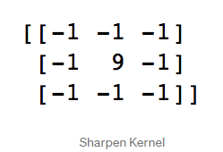
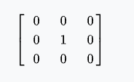
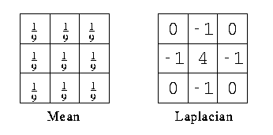
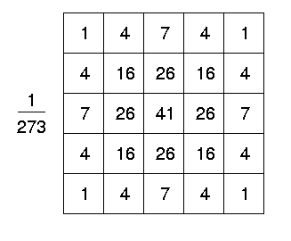
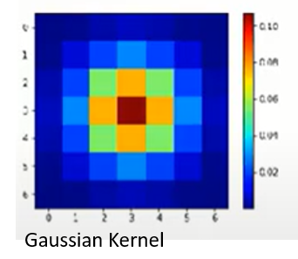
Kernels
50
50
55
50
50
50
55
50
255
50
50
1/8
1/8
1/8
50
50
50
50
50
One to one multiplication
1/8
0
1/8
50
50
50
50
50
50
50
50
50
50
50
1/8
1/8
1/8
50
50
50
50
50
50
50
45
50
50
50
45
50
Input / Image
Kernel
Output /Image
Sharpening kernel
Identity kernel
Notes:
https://medium.com/@bdhuma/6-basic-things-to-know-about-convolution-daef5e1bc411?p=95fb03f45a9

Slide 17
Kernel Vs Filters
A kernel is a matrix of weights which are multiplied with the input to extract relevant features. The dimensions of the kernel matrix is how the convolution gets it’s name. For example, in 2D convolutions, the kernel matrix is a 2D matrix.
A filter however is a concatenation of multiple kernels, each kernel assigned to a particular channel of the input. Filters are always one dimension more than the kernels. For example, in 2D convolutions, filters are 3D matrices (which is essentially a concatenation of 2D matrices i.e. the kernels). So for a CNN layer with kernel dimensions h*w and input channels k, the filter dimensions are k*h*w.
Structuring Elements
cv2.getStructuringElement
4 neighbourhood structuring element
6 neighbourhood structuring element
Circular
Rectangular
Notes:
Types of Convolution Kernels : Simplified | by Prakhar Ganesh | Towards Data Science

Slide 18
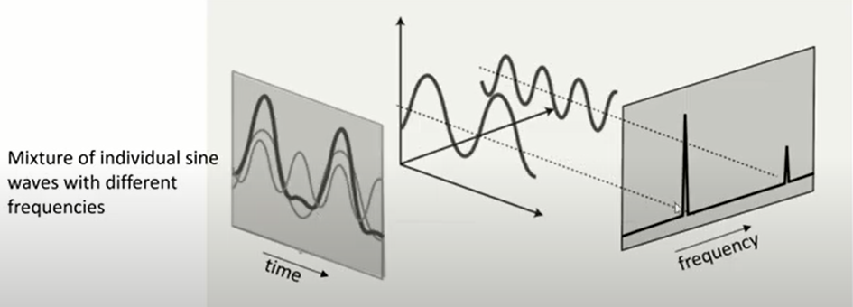
FOURIES TRANSFORM
FT breaks any signal or function into a combination of sin and cosine function, in simple it proves that any signal can be reconstructed by summing of sine and cosine waves.
Input signal
FT frequency domain
I/P signal in time domain

Slide 19
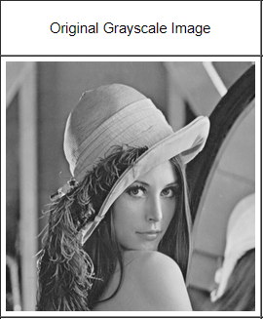
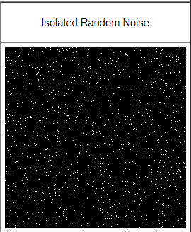
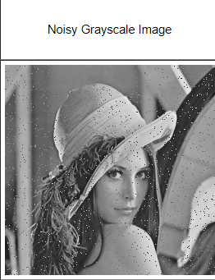
Generic Terms
Noise --- Unwanted pixels on the image ,eg too many grains in the image is a noise
Additive Noise /Gaussian Noice
Noise spikes/speckle - Isolated pixels of exceptionally low or high pixel intensity .e.g. salt and pepper noise
Image
Noise
Image with Noise
Spatial Resolutiion
Spatial Resolution is the number of independent pixel values per inch,So to compare the resolution of two images them both should be of same size
Contouring
Contouring is an effect when we reduct the pixels from high bit to low bit ,eg 256 Gray level to 16 Gray level.

Slide 20
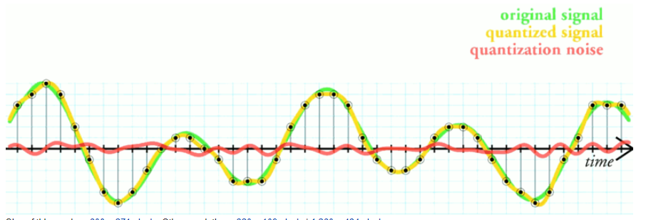
Generic Terms
Quantization of Digital image processing
The simplest way to quantize a signal is to choose the digital amplitude value closest to the original analog amplitude. This example shows the original analog signal (green), the quantized signal (black dots), the signal reconstructed from the quantized signal (yellow) and the difference between the original signal and the reconstructed signal (red). The difference between the original signal and the reconstructed signal is the quantization error and, in this simple quantization scheme, is a deterministic function of the input signal.
Blob
A Blob is a group of connected pixels in an image that share some common property ( E.g grayscale value )
Notes:
File:Quantization error.png - Wikipedia

Slide 21
IMAGE PRE -PROCESSING
SMOOTHERING FILTERS OR DENOISING FILTERS OR IMAGE BLURING
IMAGE THRESHOLDING
SHARPENING FILTERS
HISTOGRAM EQUILIZATION
MORPHOLOGICAL OPERATIONS
EDGE DETECTIONS
IMAGE PYRAMIDS
CORNER DETECTION
Notes:
OpenCV: Image Processing (imgproc module)

Slide 22
HISTOGRAM EQUALIZATION

Slide 23
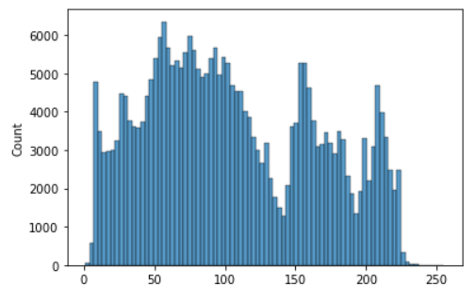
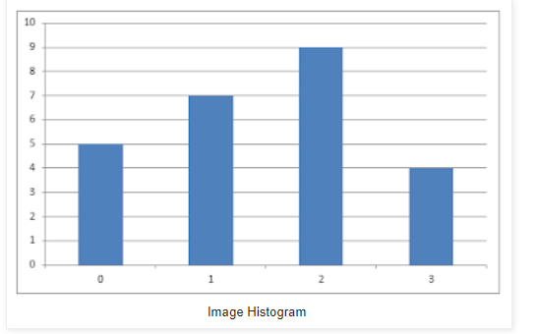
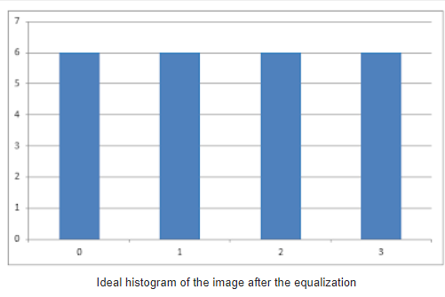
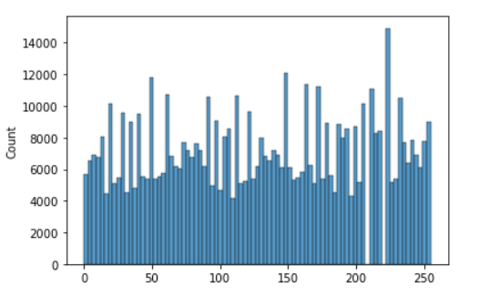
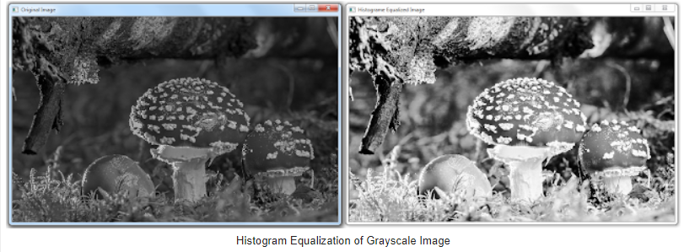
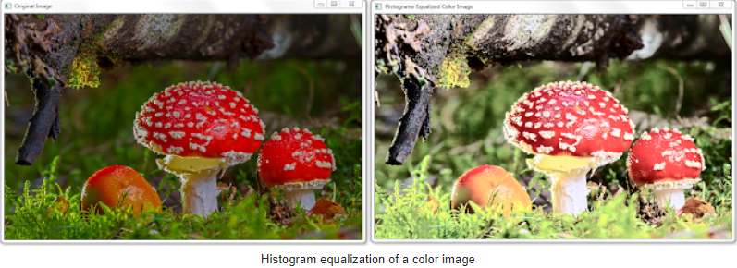
Histogram Equalization for Contrast
This technique is used to enhance the contrast of an image by make the dark image less dark and bright image less bright
Existing pixels and its counts
Pixel counts after an ideal HE applied
Notes:
https://homepages.inf.ed.ac.uk/rbf/HIPR2/gsmooth.htm

Slide 24
IMAGE PRE -PROCESSING
DENOISING / SMOOTHENING FILTERS

Slide 25
Image Bluring
Smoothing and blurring is one of the most important pre-processing steps in all of computer vision and image processing. By smoothing an image prior to applying techniques such as edge detection or thresholding we are able to reduce the amount of high-frequency content, such as noise and edges.
By blurring we can reduce the detail in an image, since more easy to find objects that we are interested in.
Also this allows us to focus on the larger structural objects in the image.
Smoothing an image allows us to ignore much of the detail and instead focus on the actual structure.

Slide 26
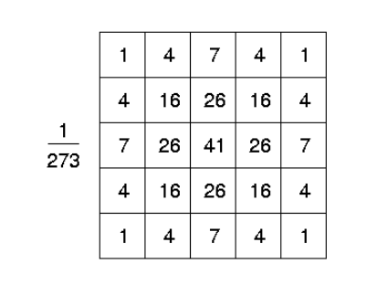
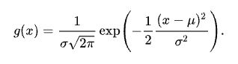
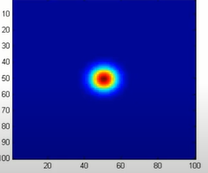
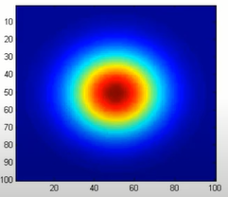
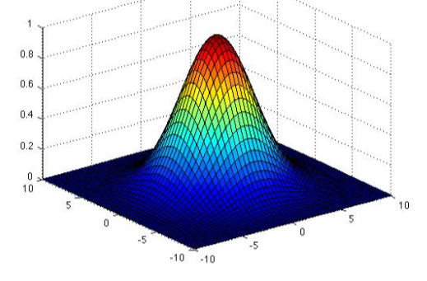
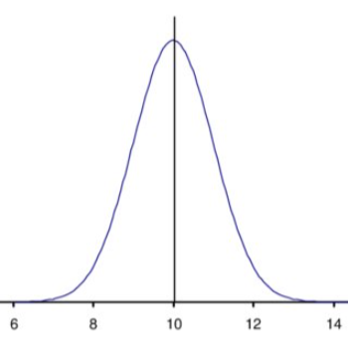
DENOISING OR SMOOTHENING FILTERS
Gaussian Smoothening Filters (can be applied multiple channel images)
It is like the mean filter, but it uses a different kernel that represents the shape of a Gaussian (`bell-shaped') hump.
This reduces the noise, but it will blur the image, or we will lose some details of the images Not preferred because image got blurred
The Gaussian outputs a `weighted average' of each pixel's neighbourhood, with the average weighted more towards the value of the central pixels. Because of this, a Gaussian provides gentler smoothing and preserves edges better than a similarly sized mean filter.
Gaussian Kernel
Sigma – Standard Deviation
In Gaussian Filter we can define the Standard Deviation as well as the Kernel size
Shape of Gaussian with
Small Sigma (TopView)
Shape of Gaussian with
Large Sigma (Top View)
3 D Gaussian curve
2 D Gaussian curve

Slide 27
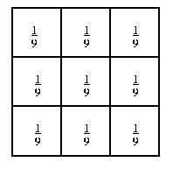
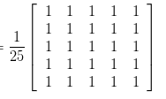
DENOISING OR SMOOTHENING FILTERS
MEAN FILTER /HOMOGENIOUSE BLUR 4 Noise reduction
The idea of mean filtering is simply to replace each pixel value in an image with the mean (`average') value of its neighbours, including itself.
This can be used to smoothening the image.
This has the effect of eliminating pixel values which are unrepresentative of their surroundings.
A larger kernel 5X5 can be used for more severe smoothening.
3 X3 Kernel for mean filtering
5X5 Kernel for mean filtering
50
50
55
50
50
50
55
50
80
50
50
1/9
1/9
1/9
50
53
50
50
50
One to one multiplication
1/9
1/9
1/9
50
50
50
50
50
50
50
50
50
50
50
1/9
1/9
1/9
50
50
50
50
50
50
50
45
50
50
50
45
50
Input Image
Centre Pixel ,wrt Kernel
Kernel
Output Image
*One to one Multiplication
(50/9) + (50/9) + (50/9) + (50/9) +(80/9) +(50/9) +(50/9) +(50/9) +(50/9) + (50/9) = 53.322

Slide 28

DENOISING OR SMOOTHENING FILTERS
Meadian Filter 4 noise reduction
Median filtering is simply to replace each pixel value in an image with the median value of its neighbours, considering itself.
This method is more robust than mean since the unrepresentative surrounding pixels(outliers) will not effect the resultant or median pixel value.
It preserves the edges better than the mean since median is one of the existing pixel value , rather than a new pixel value generated by mean.
Threshold Averaging
This is a variations on the mean smoothing filter.
Threshold Averaging wherein smoothing is applied subject to the
condition that the center pixel value is changed only if the difference
between its original value and the average value is greater than a preset threshold.
This has the effect that noise is smoothed with a less dramatic loss in image detail.
Notes:
https://homepages.inf.ed.ac.uk/rbf/HIPR2/gsmooth.htm

Slide 29

DENOISING OR SMOOTHENING FILTERS
Conservative Smoothening
First finds the minimum and maximum intensity values (exclude the centre pixel) of all the pixels within a windowed region around the pixel in question or central pixel. If the intensity of the central pixel lies within the intensity range spread of its neighbours, it is passed on to the output image unchanged. However, if the central pixel intensity is greater than the maximum value, it is set equal to the maximum value; if the central pixel intensity is less than the minimum value, it is set equal to the minimum value.
Non Local Mean Filter (NLM Filter)
Most preferred for high pixel images with noised or pepper , and it preserves the edges. Can be used for 3d and 2d images.
Notes:
https://homepages.inf.ed.ac.uk/rbf/HIPR2/gsmooth.htm

Slide 30

DENOISING OR SMOOTHENING FILTERS
Bilateral filter
This is best to preserve edges with denoising.
Centre pixel replaces with the weighted average of the nearby pixels
Can be used for 3d and 2d images.
Sigma values: For simplicity, you can set the 2 sigma values to be the same. If they are small (< 10), the filter will not have
much effect, whereas if they are large (> 150), they will have a very strong effect, making the image look
"cartoonish".
Filter size: Large filters (d > 5) are very slow, so it is recommended to use d=5 for real-time applications, and perhaps d=9 for
offline applications that need heavy noise filtering.
Notes:
https://homepages.inf.ed.ac.uk/rbf/HIPR2/gsmooth.htm

Slide 31
DENOISING OR SMOOTHENING FILTERS
Total Variation Filter (TVF)
Block Matching and 3D Filter (BM3D)
Notes:
https://homepages.inf.ed.ac.uk/rbf/HIPR2/gsmooth.htm

Slide 32
Thresholding

Slide 33



Image Thresholding
Thresholding is the simplest method of segmenting images.
Example it can divide the image into background and the foreground

Slide 34

Image Thresholding

Slide 35

Thresholding Methods
There are different methods to find the best thresholding value , so to improve the output threshold image
Global Thresholding
It has only single threshold value to segment
Adaptive Thresholding /Dynamic Thresholding
In Adaptiive thresholding the thresholding value changed dynamically across the image
In adaptive thresholding the image is divided into different segments and apply global thresholding to each segment of the image.Below are three main types of Adaptive Thresholding
Thresh_mean_c Threshold Value = (Mean of the neighbourhood area values – constant value). In other words, it is the mean of the blockSize×blockSize neighborhood of a point minus constant.
Thresh_gaussian_c (Gaussian-weighted sum of the neighbourhood values – constant value). In other words, it is a weighted sum of the blockSize×blockSize neighborhood of a point minus constant.
Otsu Method -is very useful If the boundaries of foreground and background is not very clear.
Notes:
(213) Otsu's Method - YouTube

Slide 36
EDGE DETECTION

Slide 37




Edges
Edges can be identified with respect to the behaviour of the variation of pixels across specific direction
120
40
40
40
160
160
160
40
40
80
120
160
160
40
80
120
120
80
40
40
80
100
100
80
40
Step Edge
Ramp Edge
Ridge Edge
Roof Edge
Notes:
https://homepages.inf.ed.ac.uk/rbf/HIPR2/gsmooth.htm

Slide 38
Edge Detection Filters
The edge detection eliminates the information's in order to focus only on a specific variations set on the image based on the geometric and structural characteristics of the examined objects in order to recognize the borders. An example of such a variation is constituted by the region of pixels where the light intensity undergoes abrupt changes. Those rapidly variating regions can be identified as the edges of a certain object on the image.
Sobel ^{*best among them all}
Roberts ^{diagonal edges}
Scharr
Farid
Prewitt
Canny Edge Detection algo
Notes:
https://homepages.inf.ed.ac.uk/rbf/HIPR2/gsmooth.htm

Slide 39



Edge Detection Filters
Roberts
Prewitt
Same as Sobel only kernel values are different
Apply (convolute) horizontal and vertical filter one after another, then take sum of squares of the diff between diagonally adjacent pixels.
So it highlights the high spatial gradient which often correspond to edges.
Highlighted (red) pixel will get updated after calculating diagonal difference.
Scharr
Sobel
Same as sobel but the edges in x and y can be calculated independently,
Similar to Roberts by used 3X3 kernel
Farid
It uses two separate kernels 5X5 (interpolation) ,7X7 (differentiation)
Prewitt ,Sobel and Scharr are on same principle but only difference is Sobel and Scharr gives less weight to points far from centre pixel
Notes:
https://homepages.inf.ed.ac.uk/rbf/HIPR2/gsmooth.htm

Slide 40
Prewitt Example
No Edge
Image with Vertical Edge
Horizo Edge
50
50
50
0
0
0
0
50
50
255
255
0
615
615
0
50
50
50
50
50
50
50
50
0
0
0
50
50
255
255
0
615
615
0
50
53
0
50
50
50
50
50
50
50
50
0
0
0
0
50
50
255
255
0
615
615
0
255
255
255
255
50
50
50
50
0
0
0
0
50
50
255
255
0
615
615
0
255
255
255
255
50
50
50
0
0
0
0
50
50
255
255
0
615
615
0
255
255
50
255
255
50+50+50-50-50-50 =0
50+50+50-255-255-255=-715
Prewitt kernel is nothing but just takes the difference between the pixels vertically or horizontally

Slide 41


Edge Detection Filters
Canny Edge Detection algo
The Canny edge detector is the most well known and the most used edge detector in all of computer vision and image processing.
Its only an edge thinning process
Notes:
OpenCV Edge Detection ( cv2.Canny ) - PyImageSearch

Slide 42
Morphological Operations

Slide 43
Morphological Operations Structuring Elements
For applying simple pixel tests instead of convolution in kernels
Erosion
Dilation
Opening
Closing
Morphological gradient
Black hat
Top hat or White hat
Centre pixel
Centre pixel
4 Neighbourhood Structuring Elements
Centre pixel
8 Neighbourhood Structuring Element

Slide 44



Morphological Operations
Erosion, Dilation ,Opening, Closing and Morpho operators are suited for binary images than Gray scale.
ERROSION
Original Image
his operation erodes foreground pixels in an image at their boundaries. After this erosion operation is performed, objects in an image becomes smaller where as the holes within the object (if any) becomes larger
A foreground pixel in the input image will be kept only if all pixels inside the structuring element are > 0. Otherwise, the pixels are set to 0 (i.e., background)..
Eroded Image
DILATION
It is an opposite to Erosion.
Dilations, just as an erosion, also utilize structuring elements a center pixel p of the structuring element is set to white if ANY pixel in the structuring element is > 0.
Dilated Image

Slide 45


Morphological Operations
Opening
Is Nothing but an Erosion followed by Dilation. It will help to remove the small blobs or small patches in the images.
Original Image
Closing
This is opposite to the opening operation.
It bridge the gap between the missing parts between foreground portion
After Opening
Morphological Gradient
This is used to get the outline of the foreground part of the images.
It is the difference between the dilation and Erosion.

Slide 46
Morphological Operations
hat/white hat and the black hat operators are more suited for grayscale images than binary images.
TOP Hat
It highlights the bright region of the image with dark background. It’s the difference between the original image and opening.
White Hat
This is opposite to the opening operation.
It bridge the gap between the missing parts between foreground portion

Slide 47
Corner Detection

Slide 48
Corner Detection
heading
---
---
---

Slide 49
POOLING

Slide 50



Pooling
Pooling is performed in neural networks to reduce variance and computation complexity
There are three types of pooling operations
Max pooling: The maximum pixel value of the batch is selected.
Min pooling: The minimum pixel value of the batch is selected.
Average pooling: The average value of all the pixels in the batch is selected.
In the above image the ROI is black( ie.pixcel value 0) , in that case if we apply min pooling will give better result or make the ROI bold. In contrast if the area of interest in bright or white max pooling makes the ROI more bolt.
Notes:
https://medium.com/@bdhuma/6-basic-things-to-know-about-convolution-daef5e1bc411?p=95fb03f45a9

Slide 51
--

Slide 54

Types of filters in opencv
skimage is very slow compare to OpenCV for many operations eg bilateral filter

Slide 55
--
Spatial Domain
For simplicity, assume that the image I being considered is formed by projection from scene S (which might be a two- or three-dimensional scene, etc.).
The spatial domain is the normal image space, in which a change in position in I directly projects to a change in position in S. Distances in I (in pixels) correspond to real distances (e.g. in meters) in S.
This concept is used most often when discussing the frequency with which image values change, that is, over how many pixels does a cycle of periodically repeating intensity variations occur. One would refer to the number of pixels over which a pattern repeats (its periodicity) in the spatial domain.
In most cases, the Fourier Transform will be used to convert images from the spatial domain into the frequency domain.
A related term used in this context is spatial frequency, which refers to the (inverse of the) periodicity with which the image intensity values change. Image features with high spatial frequency (such as edges) are those that change greatly in intensity over short image distances.
Another term used in this context is spatial derivative, which refers to how much the image intensity values change per change in image position.
Frequency Domain
For simplicity, assume that the image I being considered is formed by projection from scene S (which might be a two- or three-dimensional scene, etc.).
The frequency domain is a space in which each image value at image position F represents the amount that the intensity values in image I vary over a specific distance related to F. In the frequency domain, changes in image position correspond to changes in the spatial frequency, (or the rate at which image intensity values) are changing in the spatial domain image I.
For example, suppose that there is the value 20 at the point that represents the frequency 0.1 (or 1 period every 10 pixels). This means that in the corresponding spatial domain image I the intensity values vary from dark to light and back to dark over a distance of 10 pixels, and that the contrast between the lightest and darkest is 40 gray levels (2 times 20).
The spatial frequency domain is interesting because: 1) it may make explicit periodic relationships in the spatial domain, and 2) some image processing operators are more efficient or indeed only practical when applied in the frequency domain.
In most cases, the Fourier Transform is used to convert images from the spatial domain into the frequency domain and vice-versa.
A related term used in this context is spatial frequency, which refers to the (inverse of the) periodicity with which the image intensity values change. Image features with high spatial frequency (such as edges) are those that change greatly in intensity over short image distances.

Slide 56


Slide 58
1
8
(0,0)
(0,1)
(0,2)
(0,7)
0
0
8
8
(1,0)
15
(3,7)
13
Storing it into a digital system
3
(5,3)
Into a 8x8 pixel
(7,0)
(7,7)
0
(0,0)
(0,1)
(0,2)
(5,3)
(7,7)
Target
0
0
8
3
0
8
1
9
15
0
14
0
0
16 color scales
0
8
1

Slide 59
RBG Color Space
0
100
125
253
255
Scale of 0 to 254 for red to white
0
100
125
253
255
Scale of 0 to 254 for blue to white
0
100
125
253
255
Scale of 0 to 254 for green to white
Need Three channels to represent RBG

Slide 60



Morphological Operations
ERROSION
his operation erodes foreground pixels in an image at their boundaries. After this erosion operation is performed, objects in an image becomes smaller where as the holes within the object (if any) becomes larger
A foreground pixel in the input image will be kept only if all pixels inside the structuring element are > 0. Otherwise, the pixels are set to 0 (i.e., background)..
Original image
Image after eroded with 3X3 kernel
DILATION
It is an opposite to Erosion.
Dilations, just as an erosion, also utilize structuring elements a center pixel p of the structuring element is set to white if ANY pixel in the structuring element is > 0.

